Slide 1
Ontology based Sentiment Analysis of Twitter messages
Presented By:
Manjunath Kuruvadi (999991431)
Chinna Babu Sadam (999991439)
Ananjay Mishra (999990294)

Slide 2
Problem Statement
Determining the polarity of a textual corpus (document, sentence, paragraph etc.) and assigning a value from range of [0,9] based on the strength of the sentiment using ontology techniques.

Slide 3
Tasks Done
Data set extraction from different sources and integration
Data cleaning is done in-order to remove special characters and irrelevant data
Every tool (Jena, Twitter 4j, Indigo, Gephi) is tested independently.
All tools are integrated and output is plotted in clusters based on the ranges in gephi

Slide 4
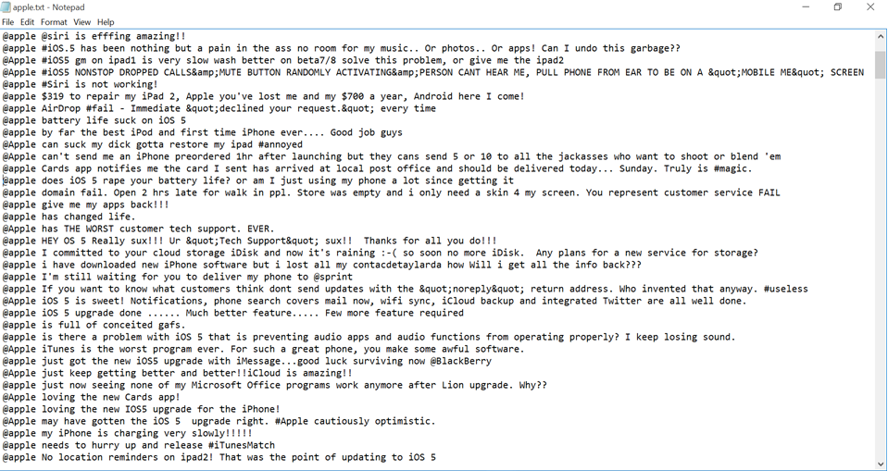
Dataset

Slide 5
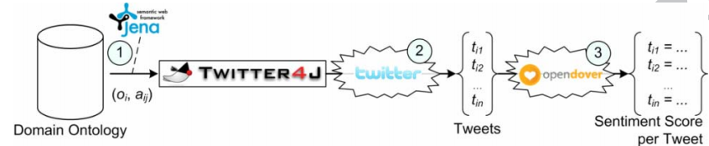
Developed Architecture
Architecture of the proposed approach
Output of sentiment grade is sent to gephi for accumulation of tweets based on similar grades and clusters are formed

Slide 6
Issues Faced
We were not able to plot the strength of the sentiment in by directly considering the tweet as an index.
Solution : we created a separate index for every tweet and mapped on to it.
We faced the data formatting issue as the output of one tool is in different format than the required input format of the next tool.
We faced some issue with the data as the indico API is not accepting certain special charecters
We faced integration issues with the openDover API which is used to generate a score, so we used indigo API instead of it.

Slide 7
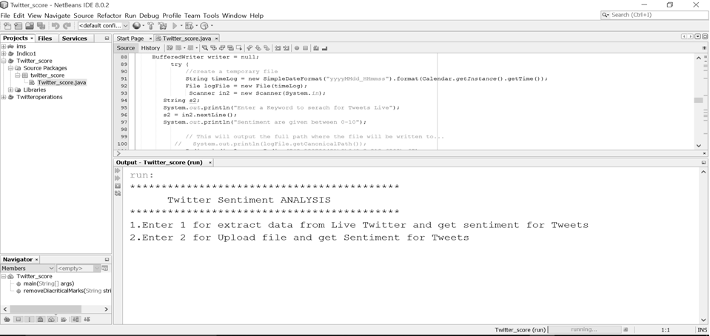
Procedure

Slide 8
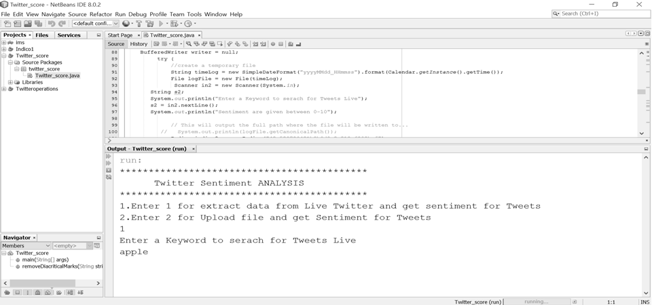
Procedure

Slide 9
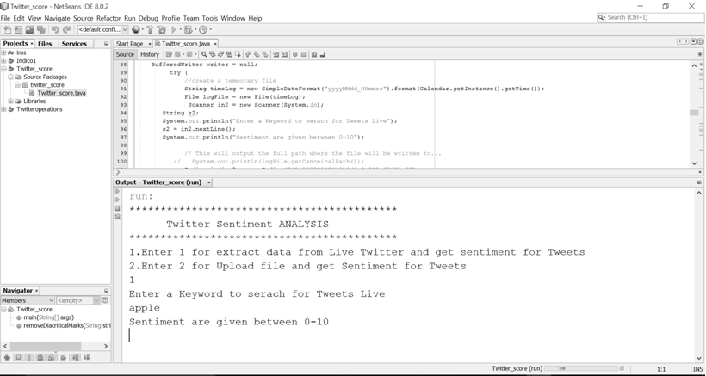
Procedure

Slide 10
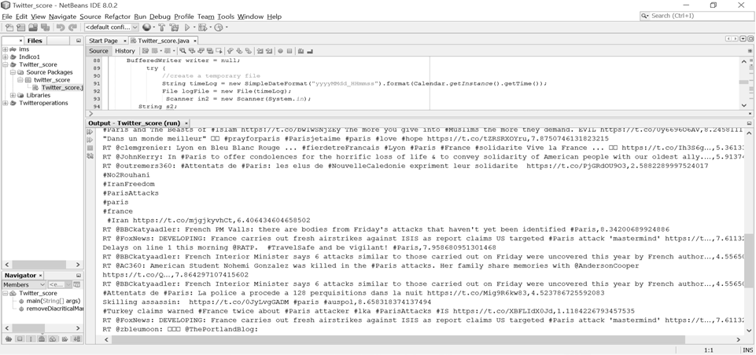
Procedure

Slide 11
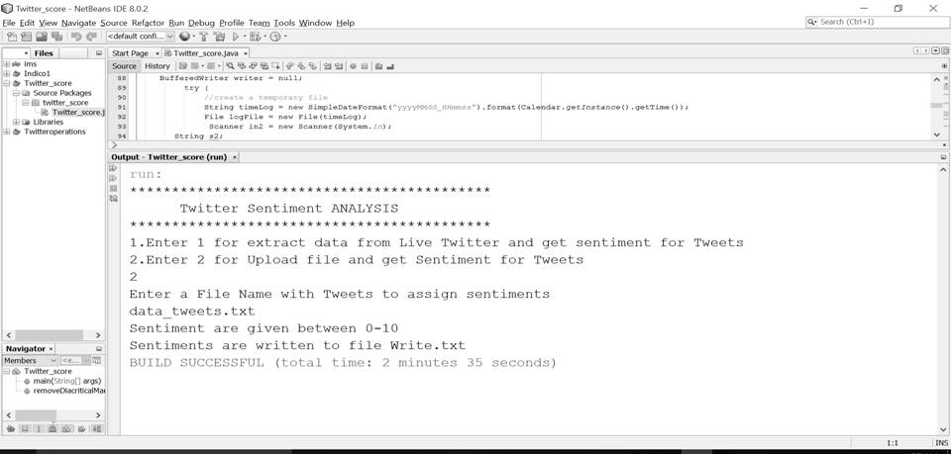
Procedure

Slide 12
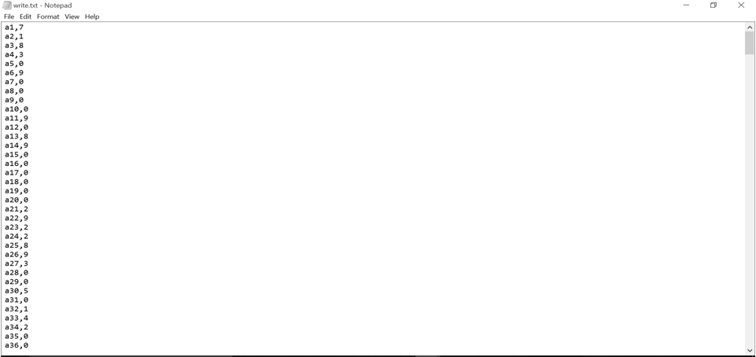
Procedure

Slide 13
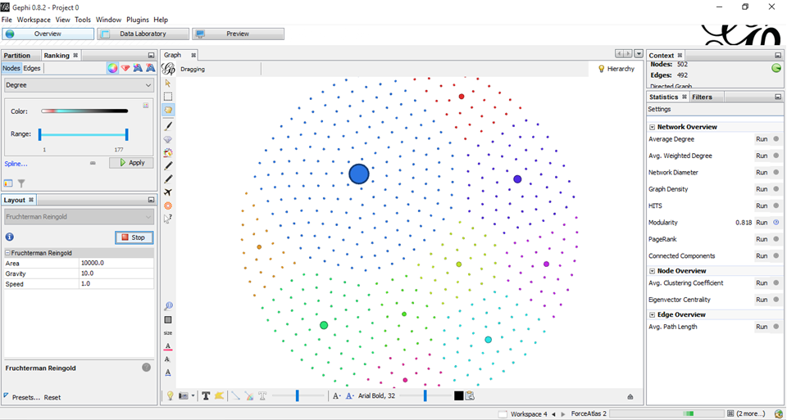
Gephi Clustering Plot

Slide 14
Relativity
Score and frequency values
Score | Frequency
0 | 177
1 | 57
2 | 44
3 | 32
4 | 22
5 | 21
6 | 31
7 | 22
8 | 29
9 | 57
332
160

Slide 15
References
http://www.researchgate.net/publication/234561261
Agarwal, A., B. Xie, I. Vovsha, O. Rambow, and R. Passonneau, (2011) “Sentiment Analysis of Twitter Data”, Proc. ACL 2011 Workshop on Languages in Social Media, 30-38
http://www.crowdflower.com/blog/data-for-everyone-why-were-creating-a-library-of-open-data

